Slide 1
Probability and statistics Mean Median Mode Variance Standard deviation
Tanu
106119130

Slide 2
Mean
PROPERTIES OF MEAN
If X and Y are random variables, then E(X + Y) = E(X) + E(Y).
For random variables, X and Y, E(XY) = E(X) E(Y). Here, X and Y must be independent.
If a is any constant and X is a random variable,
E[aX] = a E[X]
E[X + a] = E[X] + a.
Arithmetic Mean =
Sum of observations/ number of observations
Probabilistic Mean= E(x) = Σx * P(x)
x: Data value
P(x): Probability of value

Slide 3

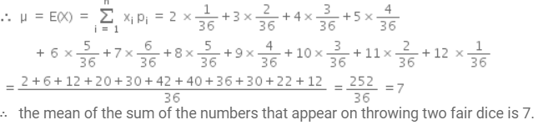
Q) Let a pair of dice be thrown and the random variable X be the sum of the numbers that appear on the two dice. What is the mean or expectation of X
a) 7 b)4 c)8 d)10
The sample space of the experiment consists of 36 elementary events in the form of ordered pairs (xi , yi ), where xi = 1, 2, 3, 4, 5, 6 and yi = 1, 2, 3, 4, 5, 6.
Sum of 2= P(X = 2) = P ( {(1,1)} )=1/36
Sum of 8= P(X = 8) = P({(2,6), (3,5), (4,4), (5,3), (6,2)}) = 5/36 etc

Slide 4

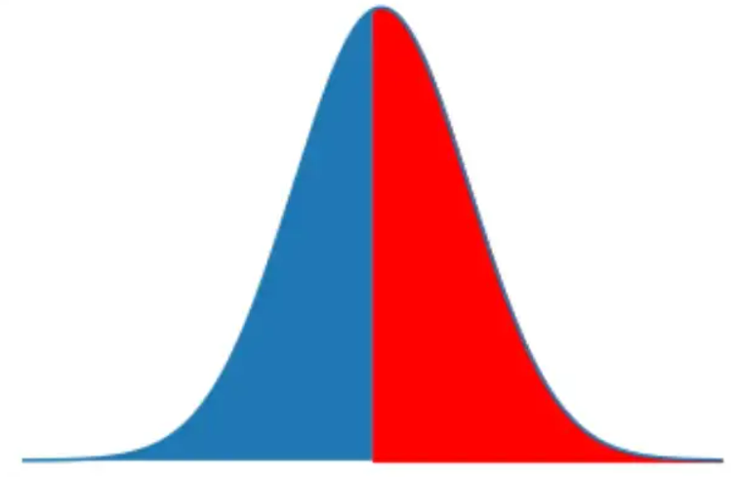
Median
The median for a random variable X is m
P(X<=m)=P(X>=m) =>
such that P(X≤m)≥1/2
and P(X≥m)≥1/2
.
Median =0 because:
P(X≤0)=P(X=0)=0.728303 and P(X≥0)=1
Mode: For a discrete random variable mode is the most probable value- 0
Median splits probability curve into 2

Slide 5
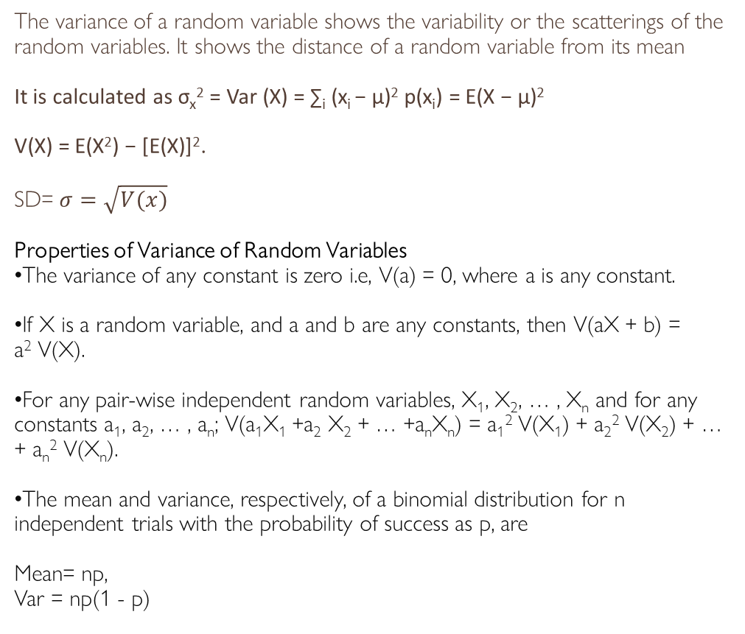
Variance and Standard deviation
The variance of a random variable shows the variability or the scatterings of the random variables. It shows the distance of a random variable from its mean
It is calculated as σ_{x}² = Var (X) = ∑_{i} (x_{i} − μ)² p(x_{i}) = E(X − μ)²
V(X) = E(X²) − [E(X)]².
SD= $σ=\sqrt{V(x)}$
Properties of Variance of Random Variables
The variance of any constant is zero i.e, V(a) = 0, where a is any constant.
If X is a random variable, and a and b are any constants, then V(aX + b) = a² V(X).
For any pair-wise independent random variables, X₁, X₂, … , X_{n} and for any constants a₁, a₂, … , a_{n}; V(a₁X₁ +a₂ X₂ + … +a_{n}X_{n}) = a₁² V(X₁) + a₂² V(X₂) + … + a_{n}² V(X_{n}).
The mean and variance, respectively, of a binomial distribution for n independent trials with the probability of success as p, are
Mean= np,
Var = np(1 - p)

Slide 6
Q)Calculate the mean and variance for a random variable, X defined as the number of tails in four tosses of a coin.
P(X = 0) = 1⁄16, P(X = 1) = 4⁄16 = 1⁄4, P(X = 2) = 6⁄16 = 3⁄8,
P(X = 3) = 4⁄16 = 1⁄4, P(X = 4) = 1⁄16
E(X) = Σ_{i} x_{i}p_{i} = 1 × 1⁄4 + 2 × 3⁄8 + 3 × 1⁄4 + 4 × 1⁄16 = 8⁄4 = 2.
E(X²) = 1² × ¼ + 2² × 3⁄8 + 3² × ¼ + 4² × 1⁄16 = ¼ + 3⁄2 + 9⁄4 + 1 = 5.
So, Variance of X = V(X) = E(X²) – [E(X)]² = 5 – 2² = 1.
SD=1
S. No. | Possible outcomes | Number of Tails, X | S. No. | Possible outcomes | Number of Tails, X
1 | THTH | 2 | 9 | THTT | 3
2 | HHTH | 1 | 10 | HHTT | 2
3 | TTTH | 3 | 11 | TTTT | 4
4 | HTTH | 2 | 12 | HTTT | 3
5 | THHH | 1 | 13 | THHT | 2
6 | HHHH | 0 | 14 | HHHT | 1
7 | TTHH | 2 | 15 | TTHT | 3
8 | HTHH | 1 | 16 | HTHT | 2

Slide 7
Consider the following probability function of a random variable X . P(x,q)= q, x=0 1-q, x=1 0 , otherwise if q=0.4, the variance of x is a) 0.36 b) 0.24 c) 0.34 d)0.55

Slide 8
Consider the following probability function of a random variable X . P(x,q)= q, x=0 1-q, x=1 0 , otherwise if q=0.4, the variance of x is a) 0.36 b) 0.24 c) 0.34 d)0.55
q=0.4
x=0, P(x)= 0.4
x=1, P(x)=0.6
E(x)= sum(xP(x))= 0*0.4+1*0.6= 0.6 ---a
E(x^2)= 0^2*0.4+1^2*0.6= 0.6 ---b
V(x)= b-a^2 =0.24

Slide 9
An examination paper has 150 MCQ’s, Of 1 mark each, with each question having four choices. Each incorrect answer fetches -0.25 mark. suppose 1000 students choose all their answers randomly with uniform probability. The sum of the expected marks obtained by all the students is
0
2550
7553
9375

Slide 10
x= -0.25, P(x)= 3/4
x=1, P(x)=1/4
E(x)= sum(xP(x))= 1*1/4+ -0.25*3/4 = 1/16
For 150 questions -150*1/16=75/8
For 1000 students -1000 *75/8 = 9375

Slide 11
Probability

Slide 12
Probability is simply how likely something is to happen
Eg: Outcome of flipping a coin
Probability of an event = (# of ways it can happen) / (total number of outcomes)
Outcome: Possible result of an experiment
Sample space: The set of all the possible outcomes to occur in any trial
Event: It is a single outcome of an experiment.
Mutually Exclusive Events: Two or more events associated with a random event are said to be mutually exclusive events if any one of the event occurs, it prevents the occurrence of all other
Exhaustive Events : Two or more events associated with a random event are said to be exhaustive events if their union is the sample space.
P(A) + P(A’) = 1
P(A∪B) = P(A) + P(B) – P(A∩B)
P(A∪B) = P(A) + P(B) if A and B are mutually exclusive/disjoint
P(A∪B∪C) = P(A) + P(B) + P(C) – P(A∩B) – P(B∩C)- P(C∩A) + P(A∩B∩C)
P(A∩B’) = P(A) – P(A∩B)
P(A’∩B) = P(B) – P(A∩B)
Notes:
Whenever we’re unsure about the outcome of an event, we can talk about the probabilities
Mutually exclusive events are those events that do not occur at the same time
A set of events are called exhaustive events if at least one of them necessarily occurs whenever the experiment is performed

Slide 13
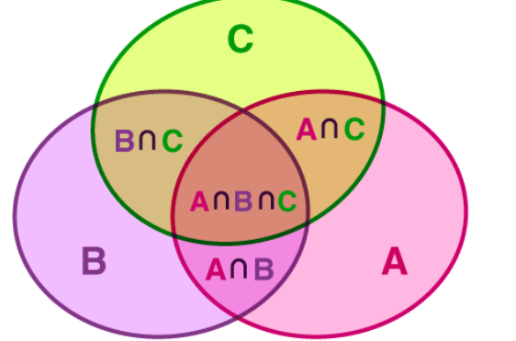
Inclusion-Exclusion principle
a counting method used to compute the cardinality of the union set
In general,
n(A1 ⋃ A2 ⋃ A3 ⋃….⋃ An) = Σn(Ai ⋂ Aj) + Σn(Ai ⋂ Aj ⋂ Ak) – ….+ (-1)n-1 n(A1 ⋂ A2 ⋂ A3 ⋂ …⋂An
Notes:
an approach which derives the method of finding the number of elements in the union of two finite sets. This is used for solving combinations and probability problems when it is necessary to find a counting method, which makes sure that an object is not counted more than once.

Slide 14
Derangements
The number of rearrangements, if n things are arranged in a row, such that none of them will occupy their original positions are called Derangements
Dn = n![1 – (1/1!) + (1/2!) – (1/3!) + …. + (-1)n(1/n!)] where n≥2
Notes:
the permutation of the elements of a certain set in a way that no element of that set appears in their original positions.

Slide 15
Q. A problem is given to students A, B, C whose chance of solving it is ½, ¾, ¼ . What is the prob that the question will be solved?
P(A) = ½ P(B) = ¾ P(C) = ¼
P(A’) = ½ P(B’) = ¼ P(C’) = ¾
P(solving) = 1 – P(not solving)
= 1 – ½ . ¼ . ¾
Notes:
We don’t know how the problem is solved, any combination can be possible
So instead of doing that we will find complement and get the probability of not solving question

Slide 16
Q. All the spades are taken out from a deck of cards, From these cards, cards are drawn one by one without replacement till the ace of spade comes. Probability of that the ace comes in the 4th draw?
Total Outcome = 13
No. of Ace = 1, Remaining card = 12
12/13 x 11/12 x 10/11 x 1/10
A

Slide 17
Q. A bag has r red balls and b black balls. All balls are identical except for their colours. In a trial, a ball is randomly drawn from the bag, its colour is noted and the ball is placed back into the bag along with another ball of the same colour. Note that the number of balls in the bag will increase by one, after the trial. A sequence of four such trials is conducted. The probability of drawing a red ball in the fourth trial?
r b
r
b
r+1, b
r, b+1
In 1st Attempt we pick one red ball So the probability = r/r+b
In 2nd Attempt we pick one red ball (Note that now in 1st Attempt we either choose red or black balls).
So probability will be= (r/r+b)* r+1/r+b+1 + (b/r+b) * r/r+b+1 = r/r+b
So, in the beginning we have r red balls, and b green balls. So, in every iteration, the probability of choosing a red ball will be r/r+b

Slide 18
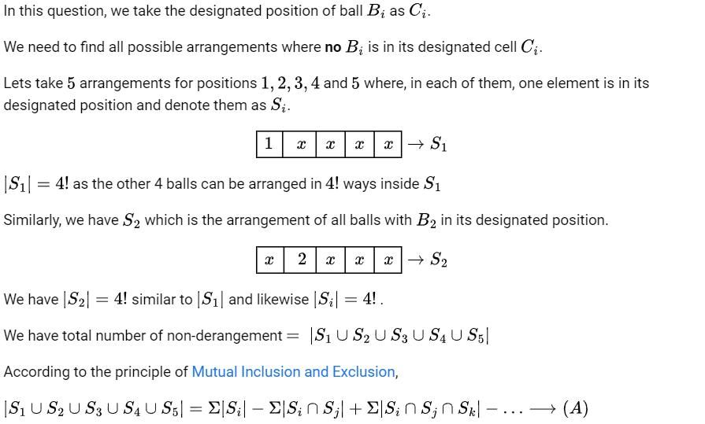
Q. In how many ways can we distribute 5 distinct balls B₁ B₂, B₃, B₄,B₅, in distinct cells C₁,C₂, C₃, C₄,C₅, such that Ball B_{i} is not in cell C_{i}, and each cell contains exactly one ball?

Slide 19
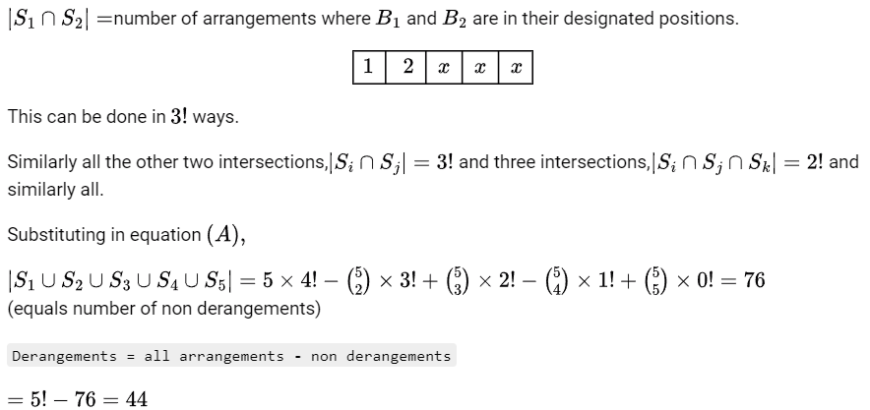

Slide 20
Q. The security system at an IT office is composed of 10 computers of which exactly four are working. To check whether the system is functional, the officials inspect four of the computers picked at random (without replacement). The system is deemed functional if at least three of the four computers inspected are working. Let the probability that the system is deemed functional be denoted by p. Then 100p = ?
Total ways to pick 4 computers = 10p4= 10*9*8*7
Total ways that at least three computers are fine =
Total ways that all 4 are fine + Total ways any 3 are fine
Total ways that all 4 are fine = 4P4 = 4*3*2*1
Total ways three are fine = 1st is Not working and other 3 working +
2nd is Not working and other 3 working +
3rd is Not working and other 3 working +
4th is Not working and other 3 working

Slide 21
= 6*4*3*2 + 4*6*3*2 + 4*3*6*2 + 4*3*2*6
= 6*4*3*2*4

Slide 22
Conditional Probability
Notes:
Kiydtyertdstpu’ihyudrtaejwsyrdkr

Slide 23
Conditional probability P(A | B) indicates the probability of event ‘A’ happening given that event B happened.
P(A | B) = P(A∩B)/P(B) [P(B) ≠ 0]
Properties:
Property 1: Let E and F be events of a sample space S of an experiment, then we have:
P(S|F) = P(F|F) = 1.
Property 2: If A and B are any two events of a sample space S and F is an event of S such that P(F) ≠ 0, then; P((A ∪ B)|F) = P(A|F) + P(B|F) – P((A ∩ B)|F)
Property 3: P(A′|B) = 1 − P(A|B)
Notes:
The probability of occurrence of any event A when another event B in relation to A has already occurred is known as conditional probability

Slide 24
Q. P and Q applying for a job. Prob that p applies for the job is 1/4 , Prob that P applies for the job given that Q applies for the job is ½ and the prob that Q applies for the job given P applies for the job is 1/3. Find prob that P doesn’t apply for the job given Q doesn’t apply for the job.
Let A = P applies for the job
B = Q applies for the job
P(A) = ¼ , P(A/B) = ½ , P(B/A) = 1/3
P(A ∩ B) = 1/3 x 1/4
P(B) = P(A ∩ B) / P(A/B) = 1/6
To find P(A’/B’) = P(A’ ∩ B’) / P(B’)
= 1 - P(A U B) / 1 - P(B)

Slide 25
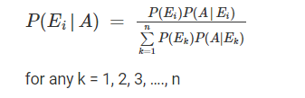
Baye’s Theorem
If A and B are two events, then the formula for the Bayes theorem is given by:
P(A|B)= P(B|A)P(A)/P(B) where P(B) > 0
Extended Baye’s Theorem:
Let E₁, E₂,…, E_{n} be a set of events associated with a sample space S, where all the events E₁, E₂,…, E_{n} have nonzero probability of occurrence and they form a partition of S.
Let A be any event associated with S, then
for any k = 1, 2, 3, …., n

Slide 26
Terminologies used:
Hypotheses: The events E₁, E₂,… E_{n} is called the hypotheses
Priori Probability: The probability P(E_{i}) is considered as the priori probability of hypothesis E_{i}
Posteriori Probability: The probability P(E_{i}|A) is considered as the posteriori probability of hypothesis E_{i .}
Bayes’ theorem is also called the formula for the probability of “causes”.
Since the E_{i}‘s are a partition of the sample space S, one and only one of the events E_{i} occurs (i.e. one of the events E_{i} must occur and the only one can occur).
It gives us the probability of a particular E_{i} (i.e. a “Cause”), given that the event A has occurred.

Slide 27
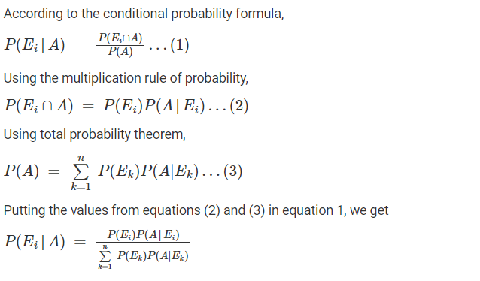
PROOF FOR BAYE’S THEOREM

Slide 28
Questions
Suppose that a shop has an equal number of LED bulbs of two different types. The probability of an LED bulb lasting more than 100 hours given that it is of Type 1 is 0.7, and given that it is of Type 2 is 0.4. The probability that an LED bulb chosen uniformly at random lasts more than 100 hours is :
(A) 0.55
(B) 0.7
(C) 0.4
(D) 0.35

Slide 29
The question is based on Bayes’ Theorem.
P(LED is Type 1) = 1/2 P(LED is type 2) = 1/2
P( LED lasting more than 100 hours / LED is Type 1) = 0.7 P( LED lasting more than 100 hours / LED is Type 2) = 0.4
P(LED lasts more than 100 hours) = P( LED is Type1)* P(LED lasting more than 100 hours / LED is Type 1) + P(LED is Type 2) * P( lasting more than 100 hours / Type 2)
= 0.5 * 0.7 + 0.5 * 0.4 = 0.35 + 0.20 = 0.55

Slide 30
2. Three companies A, B and C supply 25%, 35% and 40% of the notebooks to a school. Past experience shows that 5%, 4% and 2% of the notebooks produced by these companies are defective. If a notebook was found to be defective, what is the probability that the notebook was supplied by A?
a) ⁴⁴⁄₆₉ b) ²⁵⁄₆₉ c) ¹³⁄₂₄ d) ¹¹⁄₂₄

Slide 31
Let A, B and C be the events that notebooks are provided by A, B and C respectively. Let D be the event that notebooks are defective Then, P(A) = 0.25, P(B) = 0.35, P(C) = 0.4
P(D|A) = 0.05, P(D|B) = 0.04, P(D|C) = 0.02
P(A│D) = (P(D│A)*P(A))/(P(D│A) * P(A) + P(D│B) * P(B) + P(D│C) * P(C) ) =(0.05*0.25)/((0.05*0.25)+(0.04*0.35)+(0.02*0.4))
= 2000/(80*69) = ²⁵⁄₆₉.

Slide 32
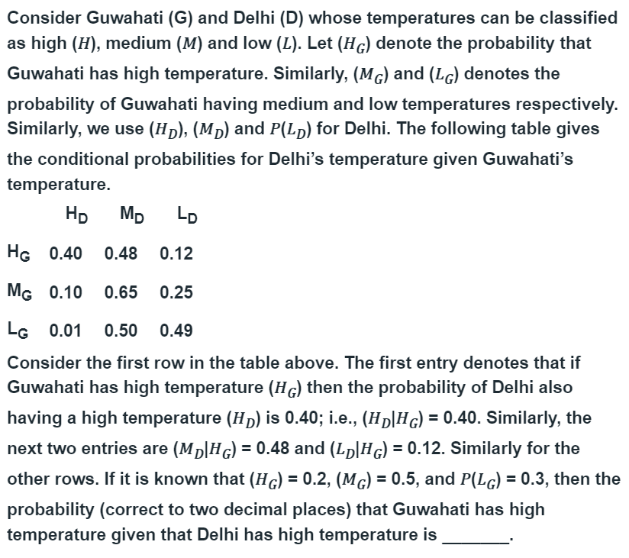
3.

Slide 33
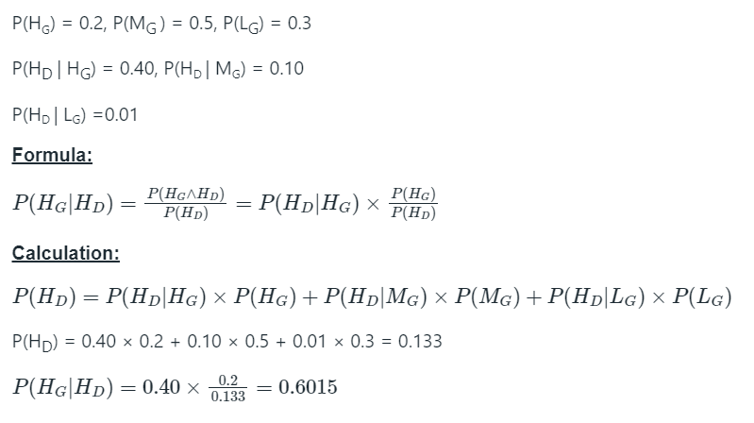

Slide 34
Binomial Distribution

Slide 35

Bernoulli Trials
A random experiment with only two possible outcomes.
Success and Failure, but they may be given any label.
Each Bernoulli trial is independent of the other.
p - the probability of Success
q - the probability of Failure.
p + q = 1 , since there are only two possible outcomes.
For example, consider the probability of the event of a even number showing up on die roll.
If E = Even number shows up, then

Slide 36
Binomial distribution and Binomial random variable
A random experiment consists of n Bernoulli trials such that
The trials are independent.
Each trial results in only two possible outcomes, labeled as “success” and “failure.”
The probability of a success in each trial, denoted as p, remains constant.
The random variable X that equals the number of trials that result in a success is a binomial random variable with parameters 0 < p < 1 and n = 1, 2,…
The probability mass function is given by-

Slide 37
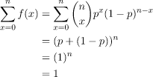

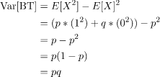

Expected Value:
Bernoulli trial : E[BT]= p*1 + q*0 = p
Binomial Distribution:
E[X] = E[BT_1] +E[BT_2]+....+E[BT_n] = nE[BT] = np (Linearity of Expectation )
Variance – n independent Random Variables,
Var[X1 + X2 .. + Xn] = Var[BT1] + …. + Var[BTn] = nVar[BT]
Standard Deviation of the distribution-

Slide 38
Questions
1. An airline sells 65 tickets for a plane with capacity of 60 passengers. The probability of a person not showing up for the flight is 0.1. All passengers behave independently. Find the probability of the event that the airline does not have to arrange separate tickets for excess people.
0.7909
0.6234
0.5783
0.8876

Slide 39
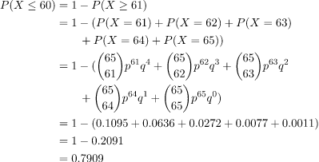
Solution – If more than 60 people show up, then the airline has to reschedule tickets for the excess number of people.

Slide 40
Questions
2. Probability of getting a total of 7 atleast once in three toss of a pair of fair dice is
0.59264
0.42129
0.48675
0.07543

Slide 41
Let A= { Sum of numbers on uppermost faces is 7}
= { (6,1), (5,2), (4,3) (3,4) , (2,5), (1,6)}
So P(A) = 6/36 = 1/6
p = P(success) = 1/6 . So q = 1 — p = 5/6
We need P( at least 1 success in 3 trials).
Now P( x success) in n trials is
P(x ) = C(n, x) q ^ (n —x) p ^x. Here n = 3
Hence P( x = at least 1 )
= P(1) + P(2) + P(3)
= 1 — P(0)
= 1 — C( 3,0) ( 5/6) ^ 3 (1/6) ^ 0
= 1 — 125/216
= 91/216
=0.42129

Slide 42
Questions
3. The probability of a boy guessing a correct answer is ¼. How many questions must he answer so that the probability of guessing the correct answer at least once is greater than ⅔?
3
4
5
6

Slide 43
p = P(guessing a correct answer) = ¼
q = P(not guessing a correct answer) = ¾
Let him answers n number of questions, then
P(X ≥ 1) = P(guessing at least one correct answer out of n questions) = 1 – P(no success) = 1 – q^{n}
Given, 1 – q^{n} > ⅔ ⇒ 1 – (¾)^{n} > ⅔
⇒ (¾)^{n} < ⅓
Now, let us check the above inequality for different values of n = 1, 2, 3, 4, …
When n = 3
(¾)³ ≮ ⅓
When n = 4
(¾)⁴ < ⅓.
Thus, he must answer at least 4 questions.

Slide 44

Exponential Distribution
The exponential distribution is a continuous probability distribution that often concerns the amount of time until some specific event happens. It is a process in which events happen continuously and independently at a constant average rate.
For example, the amount of money spent by the customer on one trip to the supermarket follows an exponential distribution.
Formula:
Probability density function:
X – Continuous random variable
- Distribution Rate

Slide 45
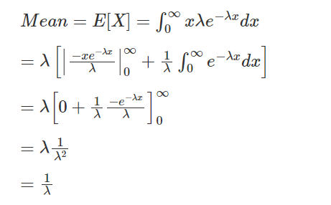


Mean and Variance of ED
Mean: Variance:
2nd moment of the exponential distribution
Var (X) = E(X²)- E(X)²

Slide 46
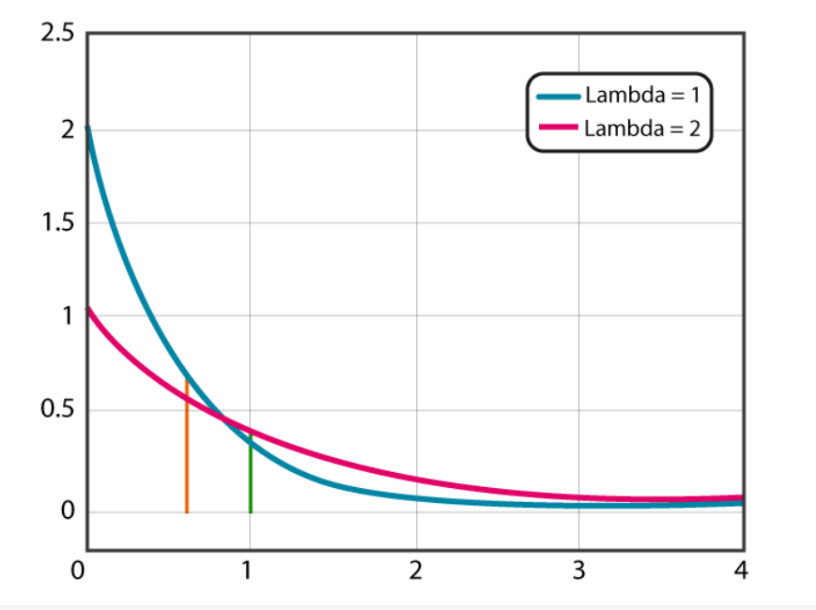
Exponential Distribution Graph
The exponential distribution graph is a graph of the probability density function which shows the distribution of distance or time taken between events.

Slide 47
Example Problem
Assume that, you usually get 2 phone calls per hour.
Calculate the probability, that a phone call will come within the next hour.
0.292
0.494
0.593
0.393

Slide 48

Example Problem
Solution:
It is given that, 2 phone calls per hour. So, it would expect that one phone call at every half-an-hour. So, we can take
λ = 0.5
Answer = 0.393469

Slide 49
Poisson Distribution
A Poisson experiment is a statistical experiment that classifies the experiment into two categories, such as success or failure. Poisson distribution is a limiting process of the binomial distribution.
A Poisson random variable “x” defines the number of successes in the experiment. This distribution occurs when there are events that do not occur as the outcomes of a definite number of outcomes.
Conditions:
The number of trials “n” tends to infinity
Probability of success “p” tends to zero
np = 1 is finite

Slide 50
Poisson Distribution
The formula for the Poisson distribution function is given by:
f(x) =(e^{– λ} λ^{x})/x!
Where,
e is the base of the logarithm, x is a Poisson random variable, λ is an average rate of value
The expected value of the Poisson distribution is given as follows:
E(x) = μ = d(eλ(t-1))/dt, at t=1.
E(x) = λ
https://www.geeksforgeeks.org/mathematics-probability-distributions-set-5-poisson-distribution
Therefore, the expected value (mean) and the variance of the Poisson distribution is equal to λ.

Slide 51
Example:
A random variable X has a Poisson distribution with parameter λ such that P (X = 1) = (0.2) P (X = 2).
Find P (X = 0).
Solution:
f(x) =(e^{– λ} λ^{x})/x!
Given that, P (x = 1) = (0.2) P (X = 2)
(e– λ λ1)/1! = (0.2)(e– λ λ2)/2!
⇒λ = (λ^2)/ 10
⇒λ = 10
Now, substitute λ = 10, in the formula, we get:
P (X =0 ) = (e– λ λ0)/0!
P (X =0) = e-10 = 0.0000454
Thus, P (X= 0) = 0.0000454

Slide 52
Difference between Poisson and Normal Distribution
The major difference between the Poisson distribution and the normal distribution is that the Poisson distribution is discrete whereas the normal distribution is continuous.
If the mean of the Poisson distribution becomes larger, then the Poisson distribution is similar to the normal distribution.

Slide 53
Gate Questions
1. Suppose p is the number of cars per minute passing through a certain road junction between 5 PM and 6 PM, and p has a Poisson distribution with mean 3. What is the probability of observing fewer than 3 cars during any given minute in this interval? (2013 CS)
(A) 8 / (2e³) (B) 9 / (2e³) (C) 17 / (2e³) (D) 26 / (2e³)

Slide 54
Q1 Solution
PR(X < 3)
= Pr(x = 0) + Pr(x = 1) + Pr(x = 2)
= f(0, 3) + f(1, 3) + f(2, 3)
Put lambda = 3 and x = 0, 1, 2
f(x) =(e^{– λ} λ^{x})/x! = 17 / (2e³)
Answer (C)

Slide 55
Questions
2. For the case of the thin copper wire, suppose that the number of flaws follows a Poisson distribution with a mean of 2.3 flaws per millimeter. Determine the probability of exactly two flaws in 2 millimeter of wire.
0.05
0.099
0.075
0.025

Slide 56
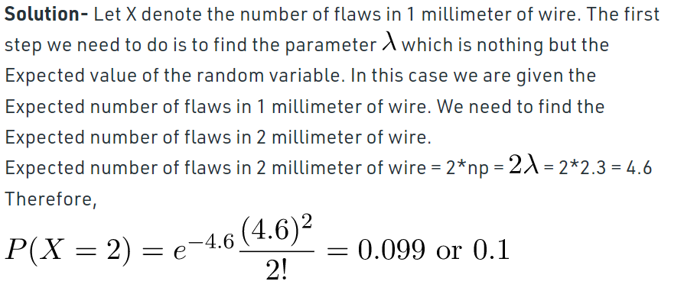
Q2 Solution

